Slide 1
Python SQLite and XML

Slide 2
Extensible Markup Language (XML)
Extensible Markup Language (XML) lets you define and store data in a shareable manner. XML supports information exchange between computer systems such as websites, databases, and third-party applications.
XML is one format programmers use to transfer data in a structure that can be parsed by all these diverse applications, and it's commonly used for creating APIs.

Slide 3
NoSQL - XML (document-based database)
XML databases are document-oriented databases
If the data design changes often, representing it as XML data is a better choice.
XML checks for errors in complex data more efficiently than JSON, as XML focuses on storing data in a machine-readable way.

Slide 4
Advantages of XML
1. XML is platform independent and programming language independent, thus it can be used on any system and supports the technology change when that happens.
2. XML supports Unicode. international encoding standard for use with different languages and scripts. This feature allows XML to transmit any information written in any human language.
3. The data stored and transported using XML can be changed at any point of time without affecting the data presentation
4. XML simplifies data sharing between various systems because of its platform independent nature. XML data doesn’t require any conversion when transferred between different systems.

Slide 5
Disadvantages of XML
1. The redundancy in syntax of XML causes higher storage and transportation cost when the volume of data is large.
2. XML document is less readable compared to other text-based data transmission formats such as JSON.
3. XML doesn’t support array.
4. XML file sizes are usually very large due to its verbose nature; it is totally dependent on who is writing it.

Slide 6
NoSQL - XML (document-based database)
https://stackabuse.com/reading-and-writing-xml-files-in-python/
https://www.studytonight.com/python-howtos/how-to-read-xml-file-in-python

Slide 7
XML parsing
XML parsing is the process of converting XML data from its serialized string format to its hierarchical format.

Slide 8
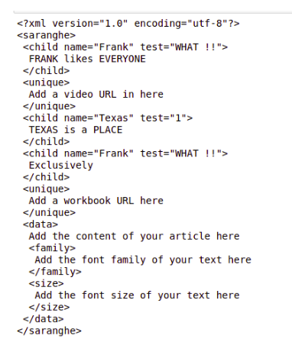
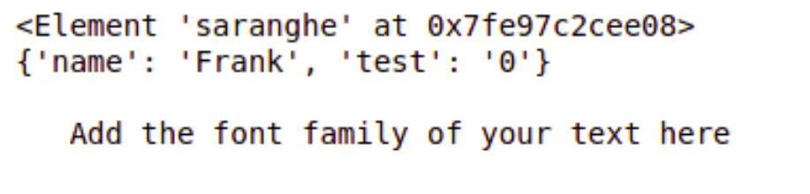
Reading XML Files (Example)
# importing element tree # under the alias of ET import xml.etree.ElementTree as ET # Passing the path of the # xml document to enable the # parsing process tree = ET.parse('dict.xml') # getting the parent tag of # the xml document root = tree.getroot() # printing the root (parent) tag # of the xml document, along with # its memory location print(root) # printing the attributes of the # first tag from the parent print(root[0].attrib) # printing the text contained within # first subtag of the 5th tag from # the parent print(root[5][0].text)

Slide 9
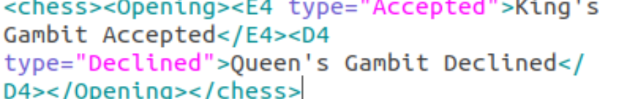
Writing/Creating XML Files Example
import xml.etree.ElementTree as ET
# This is the parent (root) tag
# onto which other tags would be
# created
data = ET.Element('chess')
# Adding a subtag named `Opening`
# inside our root tag
element1 = ET.SubElement(data, 'Opening')
# Adding subtags under the `Opening`
# subtag
s_elem1 = ET.SubElement(element1, 'E4')
s_elem2 = ET.SubElement(element1, 'D4')
# Adding attributes to the tags under
# `items`
s_elem1.set('type', 'Accepted')
s_elem2.set('type', 'Declined')
# Adding text between the `E4` and `D5`
# subtag
s_elem1.text = "King's Gambit Accepted"
s_elem2.text = "Queen's Gambit Declined"
# Converting the xml data to byte object,
# for allowing flushing data to file
# stream
b_xml = ET.tostring(data)
# Opening a file under the name `items2.xml`,
# with operation mode `wb` (write + binary)
with open("GFG.xml", "wb") as f:
f.write(b_xml)

Slide 10
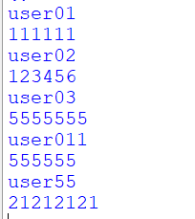
Python – XML – reading data from XML (NOSQL) document-database
import xml.etree.ElementTree as ET
def read_XML():
# Passing the path of the
# xml document to enable the
# parsing process
tree = ET.parse('items2.xml')
# getting the parent tag of
# the xml document
root = tree.getroot()
# printing the root (parent) tag
# of the xml document, along with
# its memory location
print(root)
# printing the attributes of the
# first tag from the parent
print(root[0].attrib)
# printing the text contained within
# the parent
for row in root[0]:
print(row.text)

Slide 11
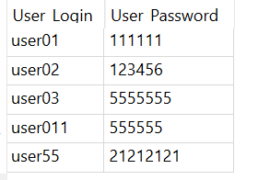
Python – XML – communication Write data from SQLite database to XML (NOSQL)
def write_xml():
connection_obj = sqlite3.connect("db1")
cursor_obj = connection_obj.cursor()
cursor_obj.execute("SELECT * FROM login_details;")
get_login_details=cursor_obj.fetchall()
# This is the parent (root) tag
# onto which other tags would be
# created
data = ET.Element('user')
# Adding a subtag named `login`
# inside our root tag
element1 = ET.SubElement(data, 'login_dartais')
# Adding subtags under the `login`
# subtag
for row in get_login_details:
s_elem1 = ET.SubElement(element1, 'login')
s_elem2 = ET.SubElement(element1, 'password')
# Adding attributes to the tags under
# `items`
#s_elem1.set('type', 'login')
#s_elem2.set('type', 'Declined')
# Adding text between the `E4` and `D5`
# subtag
s_elem1.text = row[0]
s_elem2.text = row[1]
# Converting the xml data to byte object,
# for allowing flushing data to file
# stream
b_xml = ET.tostring(data)
# Opening a file under the name `items2.xml`,
# with operation mode `wb` (write + binary)
with open("login_details.xml", "wb") as f:
f.write(b_xml)
<user><login_dartais><login>user01</login><password>111111</password><login>user02</login><password>123456</password><login>user03</login><password>5555555</password><login>user011</login><password>555555</password><login>user55</login><password>21212121</password></login_dartais></user>

Slide 12
Task: Python – XML – Read data
Convert data to XML format
Choose a table from online shop and convert it to XML format use write and read Python library methods
Next Lesson: Readings
Security and safety of SQLite database and Python:
How to create password on SQLite?
Next Lesson: To be ready: choose a topics for your assessment and collect data (flat file(s)).

